Slide 1


Blockchain based Secure Voting
Votes will go where they are supposed to!
Batch : 6
Aritra Paul | RA1611003020918
Arpan Sarkar | RA1611003020955
Sanchay Mishra | RA1611003020926
Date: 31/01/2019
Guide : V. Sathya
Designation: AP. OG .
CSE Department

Slide 2


Introduction
How EVM works and problems related to the current system

Slide 3
Introduction
Voting in this country is the most tedious job to be handled, involving all kinds of corrupted and illegal deeds. Elections in India are conducted exclusively using EVM’s developed over the past two decades by a group of government-owned companies. These devices, known in India as EVMs, have been adopted greatly for their simple design, ease of conduct, and robustness. However, recently they have also been marked prey following widespread reports of election irregularities. Despite this criticism, many details of the mechanism have never been publicly discussed, and they have not been subjected to a stringent, independent security evaluation. We conclude that in spite of the machines’ simplicity and software trusted computing base, they are vulnerable to indigenous attacks that can modify election results and violate the law of the election commission.

Slide 4

Technologies Used
The Heart of the project

Slide 5

Blockchain Cryptography
Cryptography is the method of disguising and revealing, otherwise known as encrypting and decrypting, information through complex mathematics. This means that the information can only be viewed by the intended recipients and nobody else. The method involves taking unencrypted data, such as a piece of text, and encrypting it using a mathematical algorithm, known as a cipher. Blockchain technology utilizes cryptography as a means of protecting the identities of users, ensuring transactions are done safely and securing all information and storages of value. Therefore, anyone using blockchain can have complete confidence that once something is recorded on a blockchain, it is done so legitimately and in a manner that preserves security.

Slide 6

Cloud Computing
Cloud computing is a method for delivering information technology (IT) services in which resources are retrieved from the Internet through web-based tools and applications, as opposed to a direct connection to a server. Rather than keeping files on a proprietary hard drive or local storage device, cloud-based storage makes it possible to save them to a remote database. As long as an electronic device has access to the web, it has access to the data and the software programs to run it.

Slide 7

Python Data Structures
Data structures are basically just that - they are structures which can hold some data together.There are four built-in data structures in Python - list, tuple, dictionary and set.
List: A list is a data structure that holds an ordered collection of items i.e. we can store a sequence of items in a list.
Tuple: Tuples are used to hold together multiple objects.
Dictionary: A dictionary is like an address-book where we can find the address or contact details of a person by knowing only his/her name i.e. we associate keys (name) with values (details).
Set: Sets are unordered collections of simple objects.

Slide 8

Hashing
Hashing is the transformation of a string of characters into a usually shorter fixed-length value or key that represents the original string. Hashing is used to index and retrieve items in a database because it is faster to find the item using the shorter hashed key than to find it using the original value. It is also used in many encryption algorithms.

Slide 9

Problem Statement
All the above mentioned papers are designed only for cryptocurrency and need a special algorithm to work with other aspects.
EVM is not secure with the recent developments in computer hacking.
All the above mentioned papers require high bandwidth internet connection which can't be provided in rural areas.

Slide 10

Existing Research
Related Papers on technologies used

Slide 11

Existing Research
Title | Author | Drawback
Bitcoin: A Peer-to-Peer Electronic Cash System | Satoshi Nakamoto | High Bandwidth Internet connection required
A Privacy-Preserving Voting Protocol on Blockchain | Yuan Yuan, Yanyan Hu, Shaohua Huang, Shengjiao Cao, Anuj Chopra | High Bandwidth Internet connection required Security Issues
Securing Mvoting Using Cloud Intrusion Detection and Prevention System: A New Dawn | Dina MOLOJA, Noluntu MPEKOA | High Bandwidth Internet connection required Security Issues
Blockchain-based Trusted Authentication in Cloud Radio over Fiber Network for 5G | Hui Yang, Haowei Zheng, Jie Zhang, Yizhen Wu, Young Lee, Yuefeng Ji | High Bandwidth Internet connection required End to end encryption not available.
An Offline Online Strategy for Fig. 5 System Implementation IoT using MQTT | Arya Sahadevan, Deepa Mathew, Jairam Mookatana, Bijoy A. Jose | High Bandwidth Internet connection required Security Issues
Secure Voting in the Cloud using Homomorphic Encryption and Mobile Agents | Mark A. Will, Brandon Nicholson, Marc Tiehuis, Ryan K L Ko | High Bandwidth Internet connection required

Slide 12
Existing Research
Title | Author | Drawback
Specification of a Voting Service Provider | Axel Schmidt ; Lucie Langer ; Johannes Buchmann ; Melanie Volkamer | High Bandwidth Internet connection required The paper might only be right theoratically
Improving Voting System Event Logs | Andrea L. Mascher ; Paul T. Cotton ; Douglas W. Jones | Security Issues Voting System shows logging but verification is not available
White Paper - Cloud Computing Innovation in India: A Framework and Roadmap | Anonymous | No proper future expansion plan
Block Design-based Key Agreement for Group Data Sharing in Cloud Computing | Jian Shen ; Tianqi Zhou ; Debiao He ; Yuexin Zhang ; Xingming Sun ; Yang Xiang | Security Issues Paper not implementable based on theory provided

Slide 13

Proposed Solution
Collect the ballot information from the EVM and send it to Blockchain generator.
Blockchain generator generates the blocks with data and hashes as well as connects to the previous hash.
Hash value is sent to the cloud service for remote transfer using low bandwidth internet.
The receiver station receives the data as Publish-Subscribe model and stores it in a hash table.
The hash of the blocks is compared with the hash table, if any discrepancies are found, it is rejected and marked as NOTA.
13

Slide 14
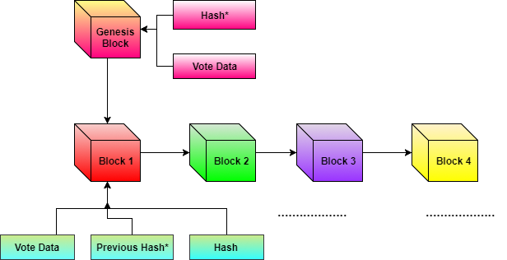
Generic Block Chain Architecture
14

Slide 15
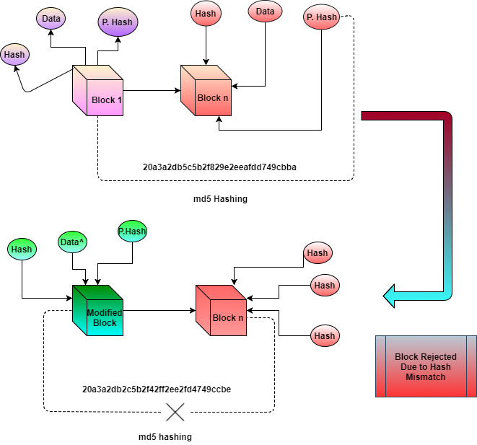
Tampered Block Architecture
15

Slide 16
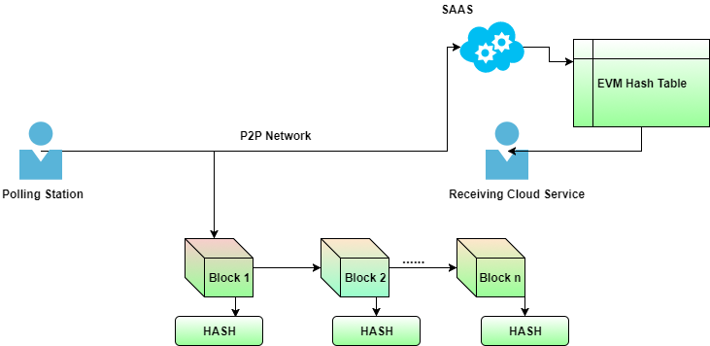
Cloud Computing Architecture
16

Slide 17
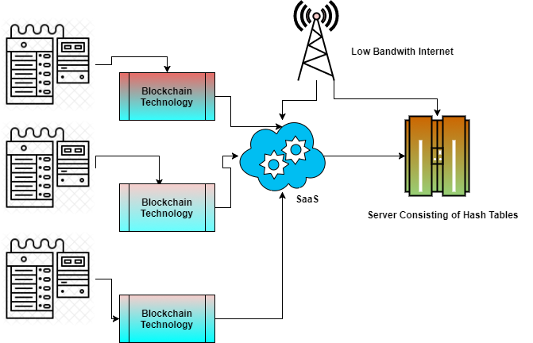
Implementation Architecture
17

Slide 18

THANK YOU
Batch 6

